Slide 1



Ondela Citywayo- Professional Portfolio Showcase
Bridging Theory with Impactful AI Solutions
Ondela Citywayo - Digital Candidate
A clean, professional background. Consider a subtle graphic that hints at AI or development.

Slide 2
My Journey into AI & Software Development
Key Points:
Grew up in love with tech movie like, Italian Job, Fast & Furious9 and many more which influenced my desire for IT and specifically Cyber Security.
Rosebank College for 3 years doing Software Development. I went to CapaCiti Digital Associate Program, an intensive program focused on end-to-end AI solution development.(e.g., bootcamp experience, key areas of study).
Expertise: Java, HTML, CSS, JavaScript, Python, ML, DL, AI, PHP, Linux(kali), Jupiter(Notebook).

Slide 3
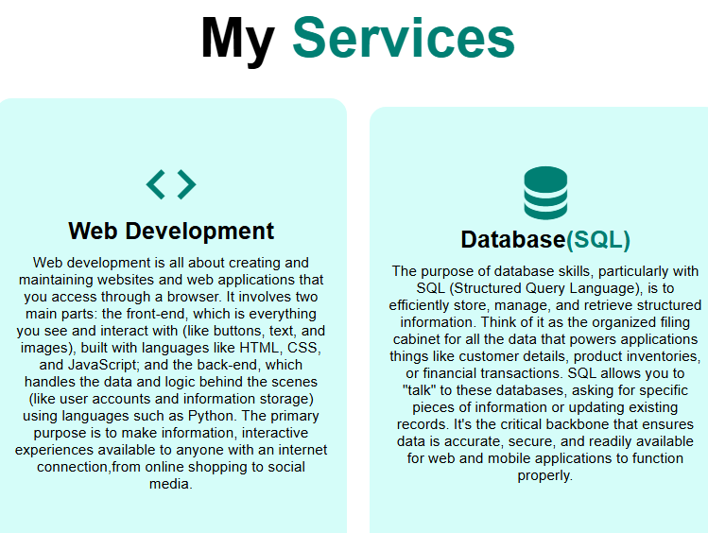
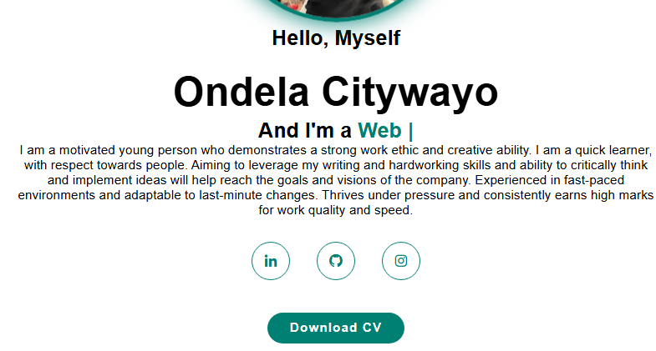
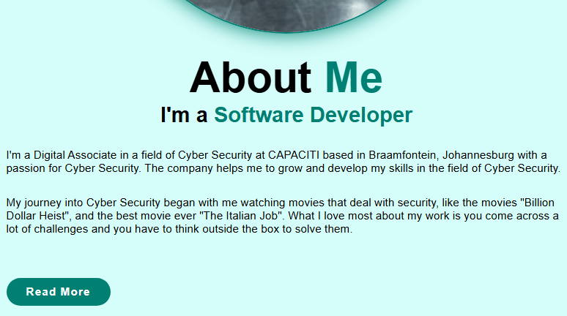
My Portfolio: Quality, Consistency & Impact
My portfolio serves as a dynamic showcase of my best and most relevant work, highlighting how I apply my technical skills to create impactful, real-world solutions. It's a curated collection designed to demonstrate my problem-solving abilities, technical proficiency, and commitment to quality in every project.
Beyond just building projects, my work is guided by core principles, I uphold principles of problem-solving focus, clean code, and user-centric design in all my projects.

Slide 4
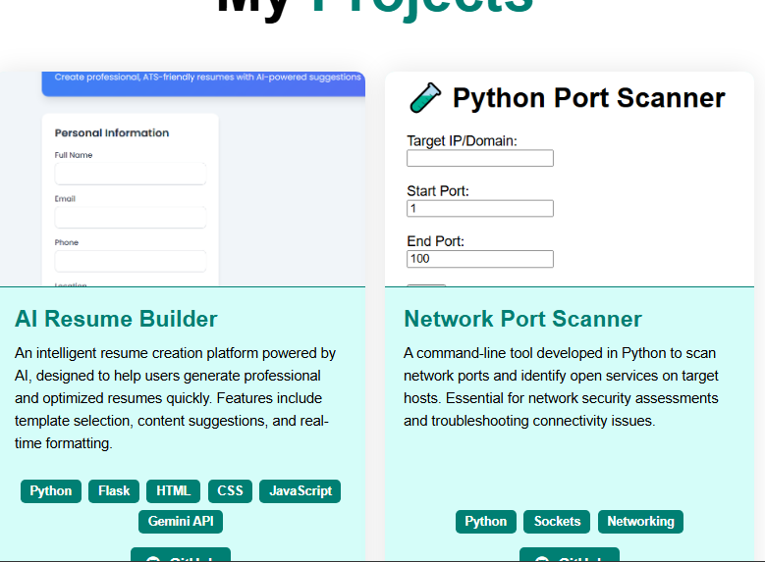
Diverse Projects, Real-World Solutions
Now, let's dive into the heart of my portfolio: my projects, where you'll see my skills applied to real-world challenges:
My portfolio encompasses a diverse range of projects, from advanced AI solutions to practical web and mobile applications
My Projects :
Password Detector: Automates resume creation with AI.
Network Port Scanner: A fundamental tool for security assessments.
Sentiment Analysis Dashboard: Visualizing real-time public opinion.

Slide 5
Capstone Project: Port Scanner
The problem my Network Port Scanner project addresses is the need for network administrators and security professionals to quickly identify open ports and services on a network. This is crucial for both security assessments (finding potential vulnerabilities) and troubleshooting connectivity issues.
Technically, it's built with Python, leveraging its socket programming capabilities for efficient network communication and port status detection.
From a technical deep-dive perspective, this project typically involves:
Core Technology: It's primarily built using Python, leveraging its robust networking capabilities.
Socket Programming: The fundamental mechanism involves socket programming. The scanner attempts to establish connections to specific ports on a target IP address.
Connection Attempts: For each port, it tries to initiate a TCP connection (or send UDP packets, depending on the scan type).

Slide 6
Response Analysis:
If a connection is successfully established (for TCP), the port is
identified as "open.“
If the connection is refused or times out, the port is typically considered
"closed" or "filtered."
Service Identification (Optional but common): More advanced scanners
might attempt to grab banners or interact with the service on an open port
to identify what application is running (e.g., HTTP server, SSH, FTP).
Concurrency: For efficiency, especially when scanning many ports or
hosts, techniques like multi-threading or asynchronous I/O
(e.g., Python's asyncio) can be employed to perform scans concurrently.

Slide 7
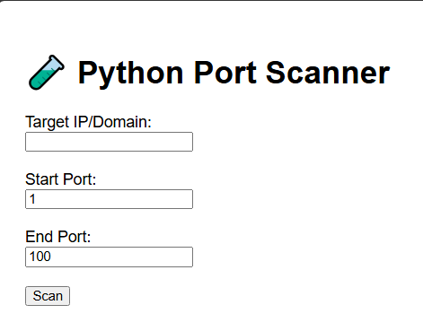
Live Demo

Slide 8
Key Technical Skills & Practical Application
Java, HTML, CSS, JavaScript, Python, ML, DL, AI, PHP, Linux(kali), Jupiter(Notebook).
My Python skills were directly applied in building the Network Port Scanner, where I leveraged socket programming to systematically probe network ports and identify open services. This project not only showcased my ability to work with networking fundamentals but also my problem-solving approach in developing tools for practical security assessments.

Slide 9
My Growth Path: Beyond the Bootcamp
What's Next: I'm currently focused on deepening my expertise in SQL & Linux practices to
streamline the deployment and management of AI models, and exploring cloud architecture
(e.g., Azure/GCP) for scalable solutions. I also plan to contribute to relevant open-source projects
to collaborate and learn from the community.
Application: I aim to apply these new skills to build more robust production-ready AI applications, ensuring they
are not only intelligent but also efficient, secure, and easily maintainable in real-world environments.
Career Aspirations: My long-term goal is to become a versatile AI Engineer, specializing in developing ethical and
impactful AI solutions that address critical industry needs, particularly within cyber security or healthcare domains.

Slide 10
Thank You & Let's Connect!
I am committed to building impactful solutions and am enthusiastic about exploring new opportunities to apply my skills.
Call to Action:
Visit my portfolio: https://github.com/Ondela1/Ondela-s-Portfolio
Connect on LinkedIn: https://www.linkedin.com/in/ondela-citywayo-8352a4251/
Email me: citywayoondela@gmail.com
Explore my code: https://github.com/Ondela1

